Slide 1
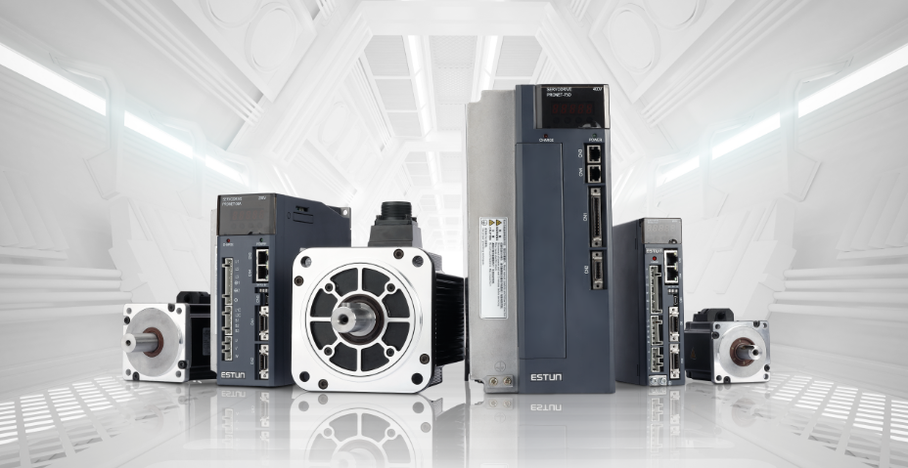
ESTUN Servo Troubleshooting
ESTUN Overseas Dep. 2020/3
We are offering reliability ,accuracy and efficiency
南京埃斯顿自动化股份有限公司
http://www.estun.com

Slide 2
Information about drive’s LED display code and Press buttons
Troubleshooting for PRONET-PLUS Series
Troubleshooting for ED3S Series’ New Alarms
Main Contents

Slide 3
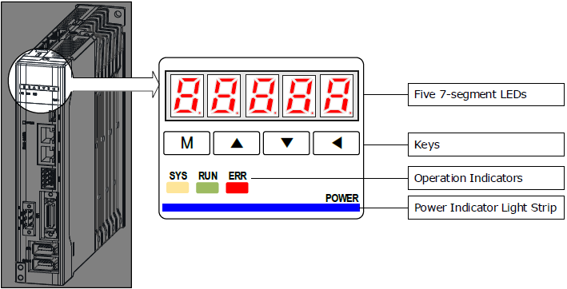
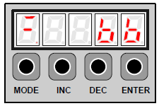
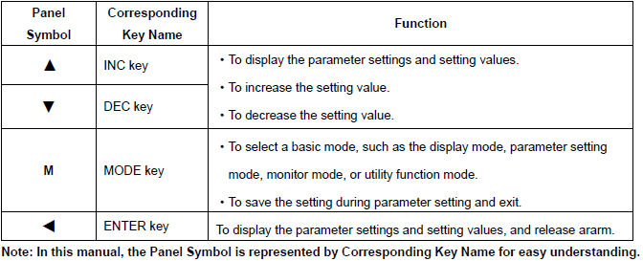
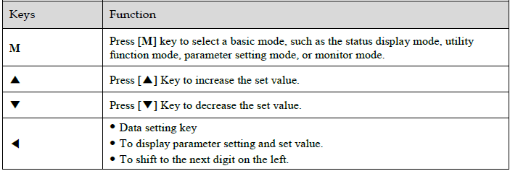
Introduction of drive’s press key

Slide 4
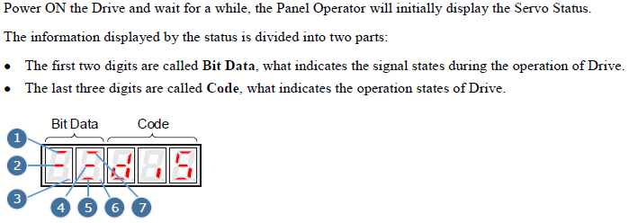
Introduction of the LED display code

Slide 5
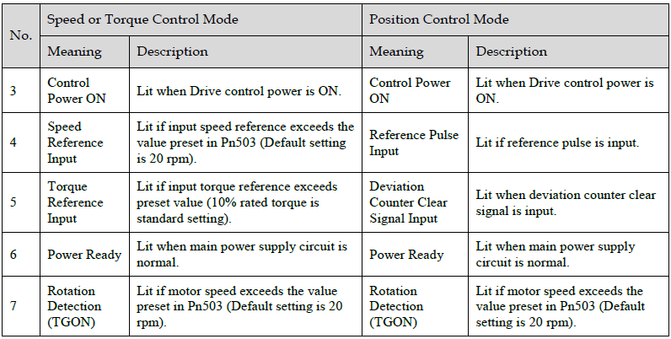
Introduction of the LED display code

Slide 6
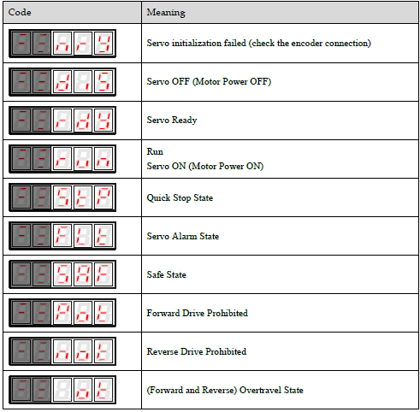
Introduction of the LED display code

Slide 7
Introduction of the LED display code
8

Slide 8
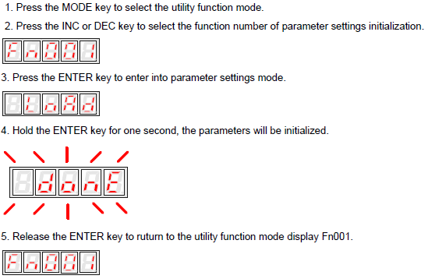
Troubleshooting for Pronet Plus Series
1. A01: Parameter breakdown
Solutions:
1. After backing up drive’s parameters, restore the drive to factory setting by operation Fn001. Operation procedures are as below:

Slide 9
Troubleshooting for Pronet Plus Series
2: A03: Over-speed
Solutions:
1. Checking the wiring sequence of U,V,W
2. When multiple servo systems are existing on one machine, make sure that the power cables are corresponding to the encoder cables one by one to preventing the crossing connections.
3. Checking the setting value of electric gear: The frequency of input pulse train command*electric gear value/per revolution of the encoder < =4500(The maximum speed of the motor)
4. If the motor has absolute encoder, please try the encoder phase angel adjusting operation Fn014/Fn012.(For the end user or the OEM customer, Please contact ESTUN before operating these two operations)

Slide 10
Procedures for Fn014/Fn012
Fn014:
Be sure the setting values of Pn005.3 and Pn840 are correct according to the model of motor.
Go to utility function mode Fn007,press the enter key. Then press INC key once and then DEC key twice and press INC key again. To unlock Fn014.
Enter Fn014,”LOAD” will be displayed, pressing the "ENTER" key and hold it , After it shows "done“. Restart the servo then operation Fn012 can be done.
Fn012:
Go to utility function mode Fn007,press the enter key. Then press INC key once and then DEC key twice and press INC key again. To unlock Fn012.
Before start operation Fn012,making sure there is no alarm on servo's LED display, alarm can be cleared by pressing "ENTER" key;
Go to Fn012 and press the enter key, "PHASE“ will be displayed. Pressing MODE key (After pressed the "Mode" key , a changing number will be displayed on the LED during that time ),wait for a moment then servo will display a stable number. After this stable number displayed, press the INC key to save the PHASE angle(LED will show "-----", After showing that, the operation is done).
Restart the servo system.

Slide 11
Troubleshooting for Pronet Plus Series
3: A04: Over-load（A12,A25,A26,A27 are similar as A04）
Solutions:
1.Parameter related:
If Pn010 set as 0,please checking the value of Pn005.3 and Pn840.2 according to the model of the motor.
If Pn010 has been set as 1, ignore this possible reason.
2.Wiring related:
Checking the wiring sequence of U,V,W and making sure they have been connected reliably.
Making sure the grounding cable of the motor and the servo power supply have been connected reliably,
If the motor has brake, making sure the power supply to the brake is working correctly.
3.Load related:
If above items have been checked without problem, then checking if there any mechanical blocking on the machine.
Monitor the value of UN003, if this value keeps above 70 when running the machine. Please consider bigger motor.
4.Application programming related:
If UN003 much bigger that 100, when start movement, but the value is small during constant speed movement.
Please consider below 3 possible reasons:
1) Try smaller acceleration;
2) Try smaller position loop gain, and bigger value of Pn103;
3) Limit the output torque of the motor by setting Pn401,Pn402

Slide 12
Troubleshooting for Pronet Plus Series
4: A07: The setting of electronic gear or given pulse frequency is not reasonable
Solutions:
1. The setting of the electric gear should be meeting below formula:
The frequency of input pulse train*electric gear/revolution of the encoder<=maximum speed of motor
2. If Pn010 set as 1, ignoring this point;
If Pn010 set as 0, checking the setting of Pn840.0 according to the model of the motor;
3.Hardware issue of the drive, replace the drive.

Slide 13
Troubleshooting for Pronet Plus Series
5: A13: Over-voltage
Solutions:
1. Checking the voltage value of the main power supply(L1,L2,L3)
2. If this alarm occurs during the movement, the reason could be the internal bleeding resistor is too small for that kind of application.
Please consider using external bleeding resistor.
3. Hardware issue, drive needs to be repaired.
Next page is about how to choose the external bleeding resistor.

Slide 14
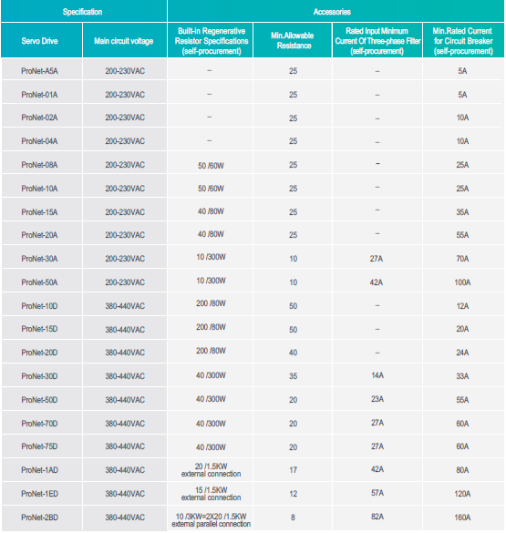

Slide 15
Troubleshooting for Pronet Plus Series
6: A14: Under-voltage
Solutions:
1. Checking the connection between⊕1 and ⊕2.
2. Checking if the power supply voltage to L1,L2,L3 is too low.
3. Hardware issue, replace the drive.

Slide 16
Troubleshooting for Pronet Plus Series
7: A15: Bleeding resistor error
Solutions:
1. Checking if any connection between B2,B3.(Not apply for the drive that below 400w).
2. Checking the resistance between B1,B3 when disconnected the jumper between B2,B3. The right value should be around the resistance of internal bleeder resistor.
3. If this alarm occurs during the movement, please consider using external bleeding resistor.
4. Hardware issue, replace drive.

Slide 17
Troubleshooting for Pronet Plus Series
8: A16: Regeneration error
Solutions:
1. Checking the connection of U,V,W & grounding wires, making sure these is no short circuit between them.
2. Make sure the voltage of power supply is not higher than the required value.
3. If this alarm occurs during the movement, please consider using a bigger power external bleeding resistor.
4. Hardware issue, replace drive.

Slide 18
Troubleshooting for Pronet Plus Series
9: A46: Absolute encoder multi-turn information overflow
Solutions:
1. Using absolute motor for below situations:
1) Motor is running in one direction;
2) The movement is reciprocating motion, but the actual position is accumulate in one direction.

Slide 19
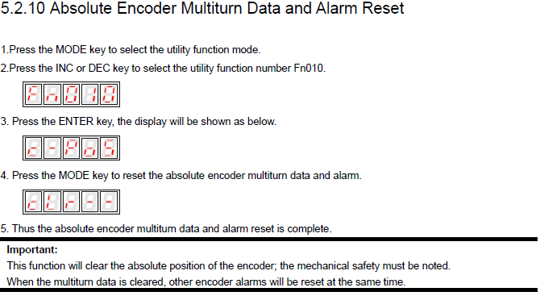
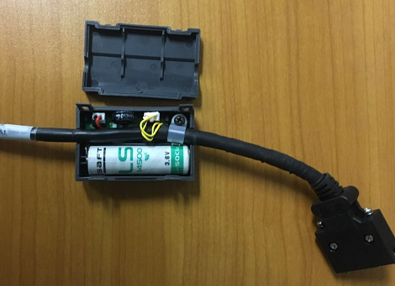
Troubleshooting for Pronet Plus Series
10: A47: Battery voltage below 2.5V(A48,A51 are similar as A47)
Solutions:
1. Checking the voltage of the battery as below pictures, and make sure the connection is OK.
2. If the voltage of the battery is OK, please try below operations:

Slide 20
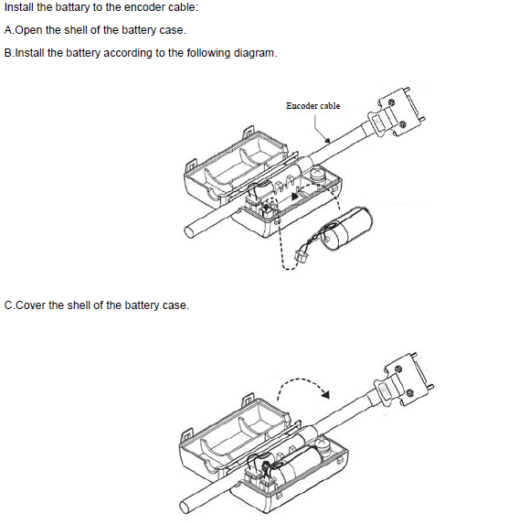
The procedures to change the battery are as below:
(Please check user’s manual Chapter 4.4.2/4.4.3 for detailed information)

Slide 21
Troubleshooting for Pronet Plus Series
11: A50: Serial encoder communication overtime(A44 is similar as A50)
Solutions:
1. Checking the encoder cable between CN2 to motor’s encoder, be sure the cable is OK.(For some special machines, please consider flexible cable).
2. Hardware issue of drive, replace the drive.
3. Encoder hardware issue.(Don’t knock on motor’s shaft and motor’s rear cover)
4. Noise issue, better shielding measures are required.(Shielding ,Grounding, Magnet rings, Filter)

Slide 22
Troubleshooting for ED3S Product about Some New common Alarms
1: A1C: Built-in Fan Error
Solutions:
1. The fan has been blocked by some small material.
2. The fan is damaged and needs to be repaired.

Slide 23
Troubleshooting for ED3S Product about Some New common Alarms
2: A20: Power Supply Line Lost
Solutions:
1. The default setting of Pn007.1 is 1, means the power supply to the drive is 3 phases. If the power supply is single phase, Pn007.1 should be set as 0.

Slide 24
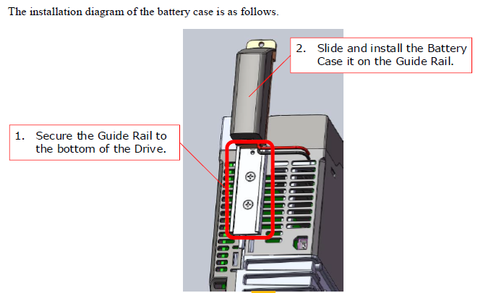
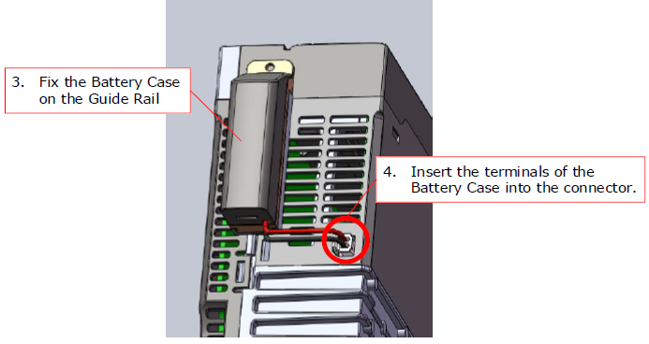
Troubleshooting for ED3S Product about Some New common Alarms
3: A47:A47: Battery voltage below 2.5V(A48,A51 are similar as A47)
Solutions：
1. ED3S has different procedures to replacing the battery. After replacing the battery ,ED3S still requires the operation Fn010 and Fn011. Procedures to replacing the battery are as below:

Slide 25
Troubleshooting for ED3S Product about Some New common Alarms
4: Alarms that related to Full-Closed Loop Control
A90，A91，A92 are corresponding to the disconnection of second encoder’s A,B,C phase wiring.
Solutions:
1: Checking the wiring of below terminals:
Terminal No. | Name | Functions:
1 | PG5V | PG5V
2 | GND | GND
3 | PA | A+
4 | /PA | A-
5 | PB | B+
6 | /PB | B-
7 | PC | C+
8 | /PC | C-

Slide 26
Troubleshooting for ED3S Product about Some New common Alarms
5. Alarms that related to Full-Closed Loop Control
A94: Position Deviation Overflow
Solutions:
1: Checking the value of Pn210.3, be sure the setting count direction is the same as the actual second encoder.
2: Checking parameter Pn212 about the revolution of the second encoder.
3: Changing the Position Deviation Threshold by Pn213.
4: Increasing the value of Pn102,Pn104 to reduce the following error.

Slide 27
Thank you

